Slide 1
Digital Rhetoric
Online Presence Presentations
Fall 2023

Slide 2


Developing an Original Game
Originates from my own interest in fantasy/magic and interaction
Explore new digital communities
Learning as I create
Difficulties of creating interaction
Work progress vs. visibility

Slide 3
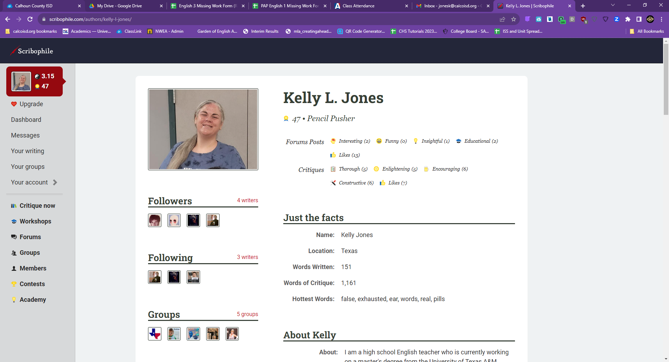
Let’s check out Scribophile together!

Slide 4

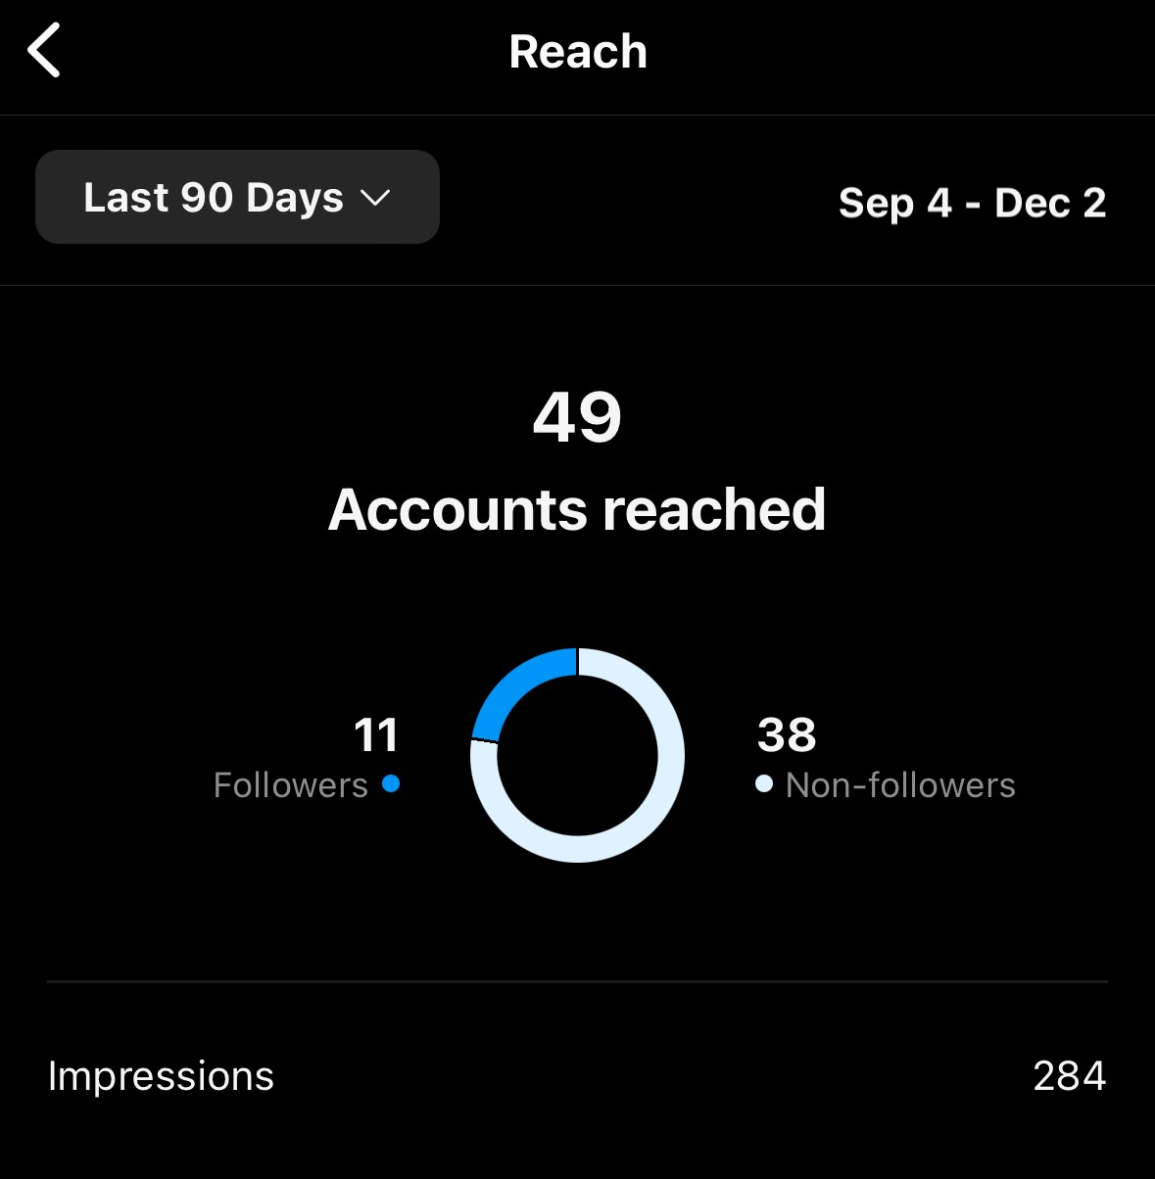
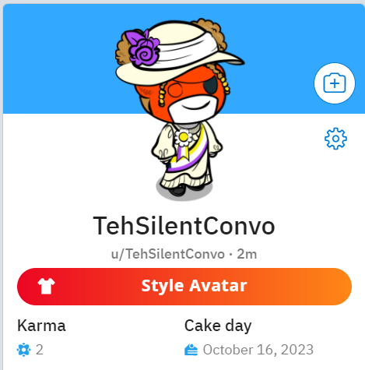

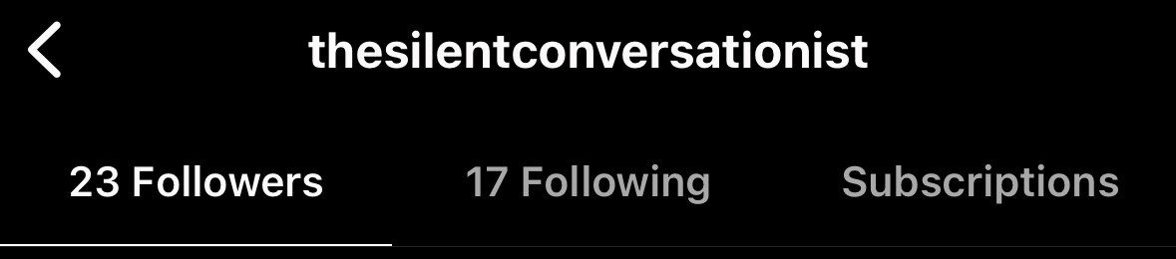
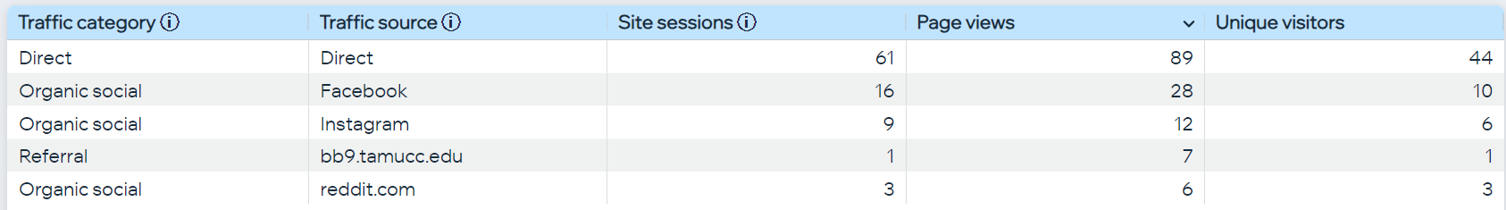
A Creative Writing Portfolio
https://www.thesilentconversationist.com/
@thesilentconversationist
Instagram Analytics: Sept. 4 to Dec. 3
Reddit Karma ^
Site Analytics: Sept. 5 to Dec. 3

Slide 5
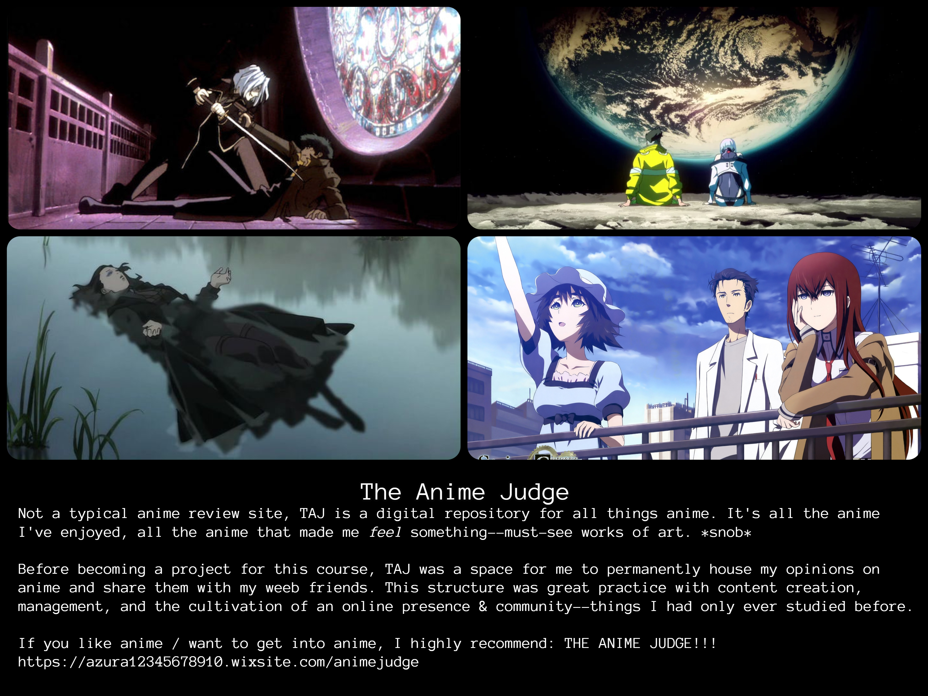

←Terrible link

Slide 6
ONLINE PRESENCE PROJECT
FOR
MONDAY MOTIVATION
DO’s DON’T’s
BE CREATIVE BE AFRAID TO ASK QUESTIONS
BE PERSISTENT FEEL LIKE YOU FAILED
BE PATIENT GIVE UP—KEEP GOING
BE CONSISTENT LET DOUBT WIN
INVOLVE FRIENDS/FAMILY IGNORE YOUR AUDIENCE
BE UNIQUE PICK TOO MANY TOPICS

Slide 7
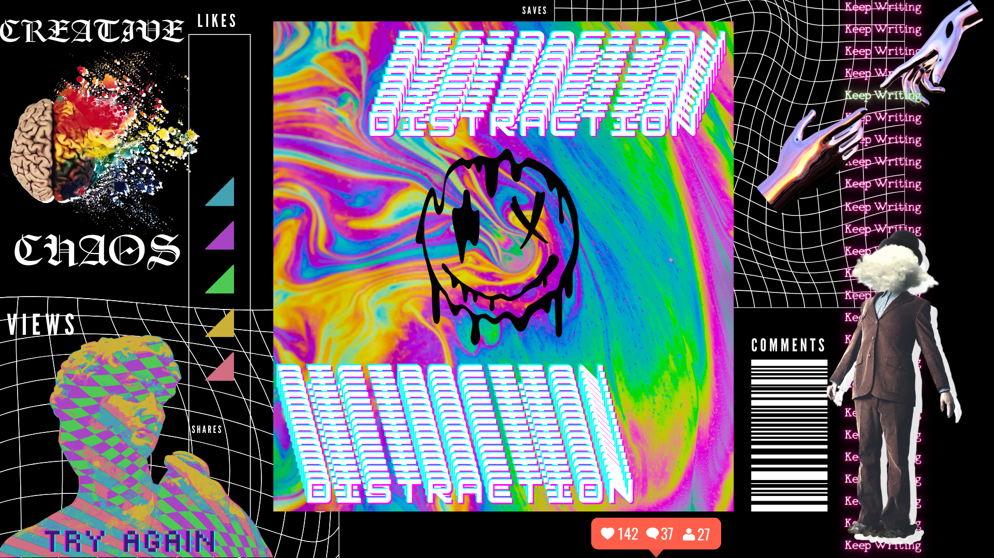

Slide 8
Cheyenne Sanchez

